Slide 1
IT1102
Computer Hardware
Week 1
Introduction to computer System and its classifications

Slide 2
Computer
Characteristics
  Make work easy
  Fast
  Accurate
  Efficient
  Versatile
  Memory
  Programmable
Modern computers
  Do concurrent jobs
  Is Intelligent?

Slide 3
Data Processing
Data
  Collection of meaningless numbers, characters
  Raw fats
  Meaning less
Information
  Processed data
  Meaning full
  Useful for decision making
  Valuable than data

Slide 4
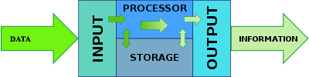
Computer
Data processing

Slide 5
Computer
  Versatile electronic device
  Programmable
  Process data
  According to a given set of instructions
Definition
Versatile electronic device, which is programmable and process data according to a given set of instructions

Slide 6
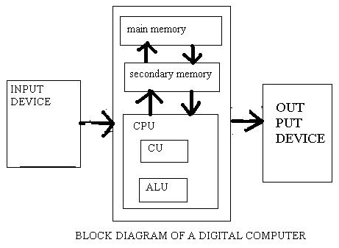

Slide 7
Computer Program
A set of instructions
  Analog or Digital signals , since it can only understand the variance of electricity.
Executed by processor
Stored in memory
Definition
  Computer Program is a set of stored instructions and data given to a computer to carry out a process
Definition
  Computer Program is a set of stored instructions and data given to a computer to carry out a process

Slide 8
Computer System - Components
Liveware
  Users
Hardware
  Tangible/physical components
Software
  Programs and data
Firmware
  Embedded instructions into electronic devices

Slide 9
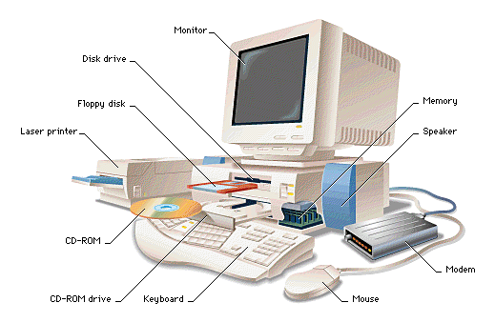
Computer Hardware
Device clarification
  Input
  Output
  Processing
  Storage

Slide 10
Computer Hardware
Input devices
Devices used to fed data into computer system
  Key board
    Indirect entry device
    Character input
    Intelligent device – own chips
    Each key is a switch – generate deferent code

Slide 11
Keyboard
Standard keyboard
  Typewriter keys
  Function keys
  Numeric & Punctuation keys
  Arrow keys
  Navigation keys
    Home, End, PgUp, PgDown
  Num Lock button
  Numeric pad
  Enter key
Laptop
Other

Slide 12
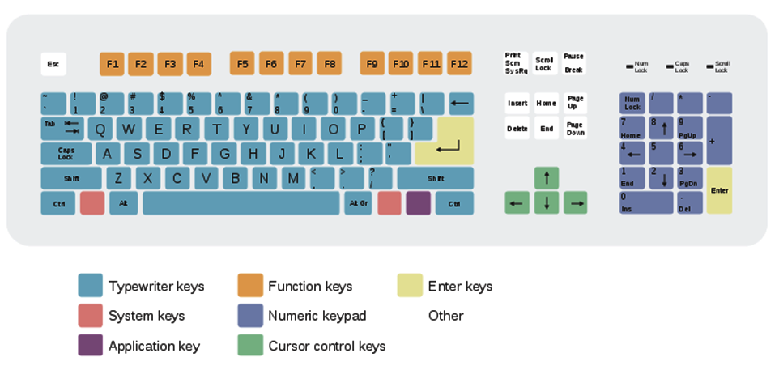
Standard Key board

Slide 13
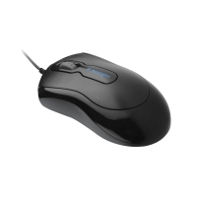
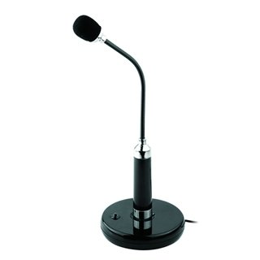
Computer Hardware
Input Devices
Mouse
  Pointing device
  Movements are translated into digital signals
  Drawing
    Traditional mouse
      Ball and electro-mechanical transducer
    Optical mouse – (LED), optical sensor
Microphone
  Convert sound in to digital signals
  Video conferencing

Slide 14
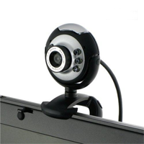
Computer Hardware
Input Devices
Camera
  Converts still /moving images into digital signals
  Video conferencing
  Chatting

Slide 15
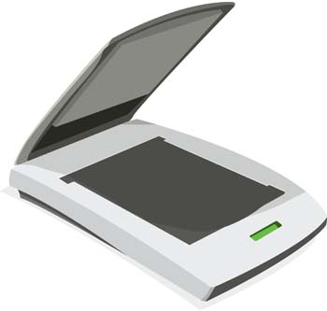
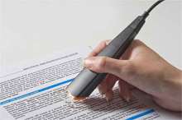
Computer Hardware
Input Devices
Scanner
  Input device
  Convert text or images into digital signals
Optical character recognition (OCR)
  Convert text image into characters.
  Scanners often come with OCR software
  Drawbacks
    Handwritten characters, symbols

Slide 16
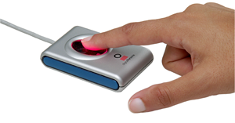
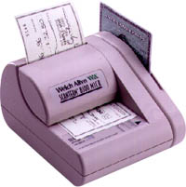
Computer Hardware
Input Devices
Fingerprint reader
  capture the fingerprint pattern
  Convert into digital format data
Magnetic Ink Character Recognition (MICR)
  Recognize characters printed in special magnetic ink into digital format
    cheques
    money

Slide 17
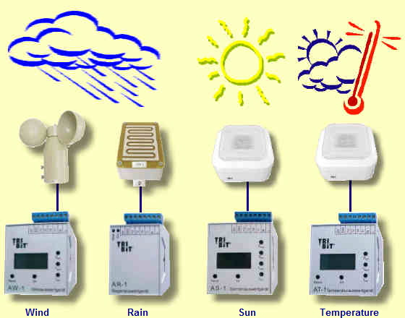
Computer Hardware
Input Devices
Environment Sensors
  Heat/ Temperature
  Humidity
  Vibration
  Wind
    Speed
    Direction
  Motion

Slide 18
Computer Hardware
Output Devices
Translate processed information into human readable format
Monitor/ Display unit
  CRT/LCD/LED
Printer
  Impact /non impact
Speaker

Slide 19
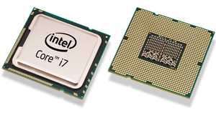
Processing Devices
CPU – Central Processing Unit
Microprocessor
  Multipurpose, programmable Integrated circuit aaccepts digital data as input and processes according to given instructions and provides output
One small chip consists number of circuits

Slide 20
Storage Devices
Store
  Data , Software
Categorizations
  Primary storage and Secondary storage
  Volatile and non-volatile
  Mutable and immutable

Slide 21
Storage Devices- Volatility
Volatile memory
  computer storage that only maintains its data while the device is powered
  Requires constant power
  Fast
  Expensive
  Cache, Main memory
Non-volatile memory
  Retain stored information even without electric power
  long-term storage of information
  Relatively cheaper
  HD, CD, DVD, Tape drive

Slide 22
Storage Devices- Mutability
  Ability to overwritten
Mutable
  Read & write
  HD, RAM, Cache
Immutable
  Read only
  Slow writing
  CD, DVD,
  ROM

Slide 23
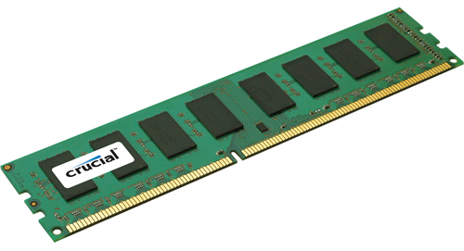
Primary Storage
Directly accessible to CPU
Location which CPU find instructions to execute
  Registers
  Cash memory
  Main memory / RAM

Slide 24
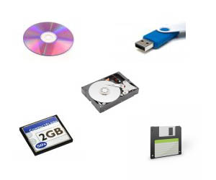
Secondary /Auxiliary Storage
Not directly accessible by the CPU
Non-volatile memory
  does not lose stored data when the device is powered down

Slide 25
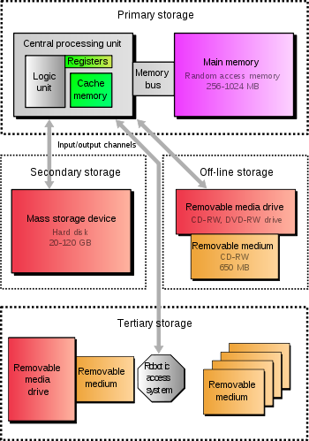
Storage Devices

Slide 26
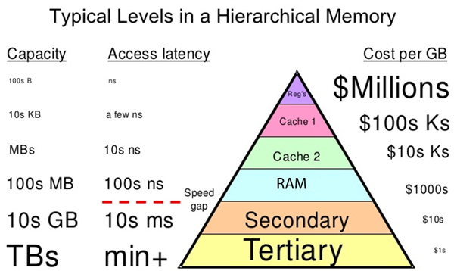
Storage Devices

Slide 27
A Brief History
1801 Weaving loom
1833 Difference engine
1945-1956 First generation computers
  Vacuum tube, Magnetic drum memory, Punched card
  ENIAC, EDVAC, UNIVAC
  1956-1964 Second Generation computers
    Transistors
    Assembly languages
  1964-1970 Third Generation computers
    Semiconductor Memories
    High level languages
  1971-Present Forth Generation computers
  Very Large Scale Integrated circuits
  Intel 4004
  1981 IBMPC, 1984 Apple Mac

Slide 28
Classifications
Computational Method
  Analog computer
  Digital computer
  Hybrid computer
Size & capability
  Super computer
  Mainframe computer
  Mani computer
  Micro computer
Purpose
  General purposes computers
  Special purposes computers

Slide 29
Classification
Computational Method
Analog computers
  Use analog signals
    Data read
    Process
    Early computers
Digital computers
  Use digital signals
    Data read
    Process
    Store
Hybrid computers
  Use analog and digital signals
    Data read – analog/ digital
    Process - digital
    Store – analog/ digital

Slide 30
Classification
Size & Capability
Super Computers
Mainframes
Mini computers
Micro computers /personal computers
  Desktop
  Laptop
  Palmtop

Slide 31
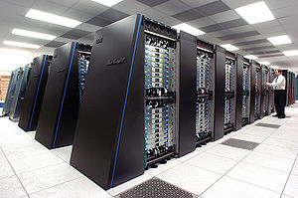
Super computers
Larger
Faster
Higher performances
Expensive
Power consumption is high
IBM's Blue Gene/P
Large number of users can work concurrently
Number of tasks can perform concurrently

Slide 32
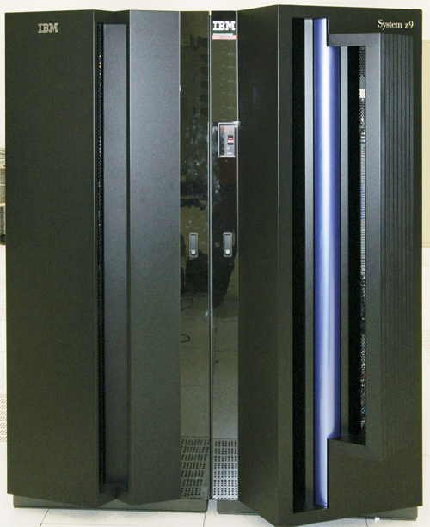
Mainframes
Larger
Faster
Higher performances
Expensive
  IBM System z9 (2005)

Slide 33
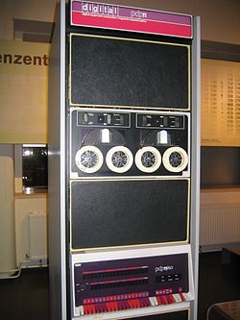
Mini Computers
Larger than desktop
Faster than desktop
Higher performances than desktop
Expensive
  PDP-8 (1965)

Slide 34
Micro computers
Desktop
  Please on a desk
  Upgrade and expansion capability
    Capable of adding additional circuitries for additional functionalities
  Introduced by IBM
  Later came IBM clones
    Similar computers by other venders
      Dell
      HP
  Apple introduced Mac

Slide 35
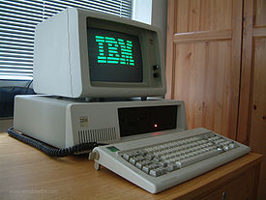
Micro computers
  IBM PC
    1981
    IBM BASIC , PC-DOS 1
    4 MHz Intel 8088
  IBM PC/XT
    1983
    4 MHz Intel 8088
    IBM BASIC , PC DOS 2.0
  IBM PC/AT
    1984
    6 MHz Intel 80286
    PC DOS,OS/2

Slide 36
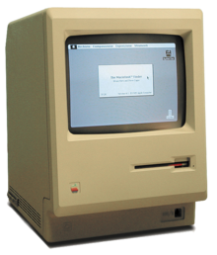
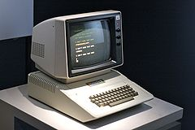
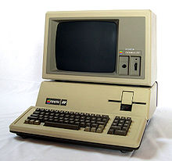
Micro computers
Apple Mac
  Motorola 6809E
Apple II
  1977
  MOS 6502
Apple III
  1980
  MOS 6502
  Apple SOS

Slide 37
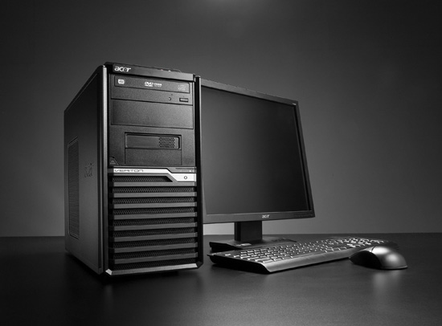
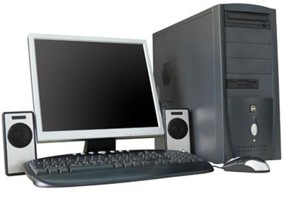
Micro computers
Tower case
  Less square area space on desk
  More upgrade and expansion capability

Slide 38
Tower case
Full tower
  36" high
  Better cooling
Mid tower
  17-20 inches high
Mini tower
  14” high
  cools better than a desktop (but not much)

Slide 39
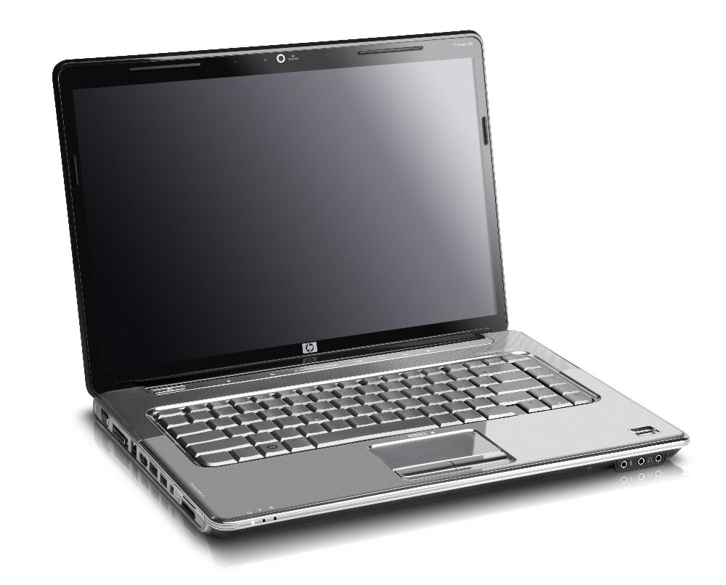
Laptop
Smaller
Compact
Cooling is less efficient
No Expansion and upgrading

Slide 40
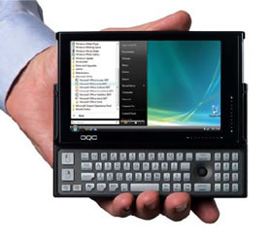
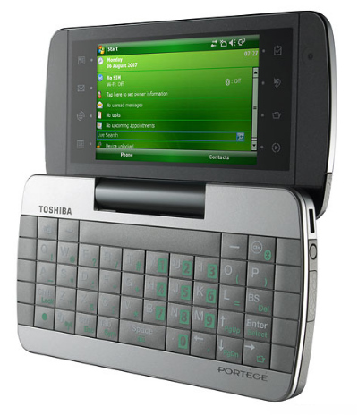
Palmtop
Smaller
Compact devices
Portable
Low power consumption
Special purposes

Slide 41
Categorizing based on Purpose
General purposes
  Programmable to any task
  Personal computer
    Word processing
    Graphic processing
    Data analyzing

Slide 42
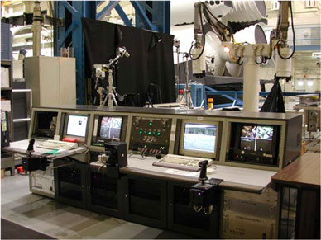
Categorizing based on Purpose
Special purposes
  Designed to used for special task
  Instructions are embedded to HW
    Space center
    Warfare
    traffic lights control system
    navigational system in an aircraft
    weather forecasting
    satellite launch / tracking
    oil exploration
    automotive industries

